Slide 1

Server-side execution
Server-side execution of:
JavaScript
Node.js
Express
Asynchronous execution
Callbacks vs. Promises

Slide 2
Project 01
Goals?
Experience with AWS
Experience with Python and SQL
Setup infrastructure for future projects

Slide 3
Project 01 => Project 02

Slide 4
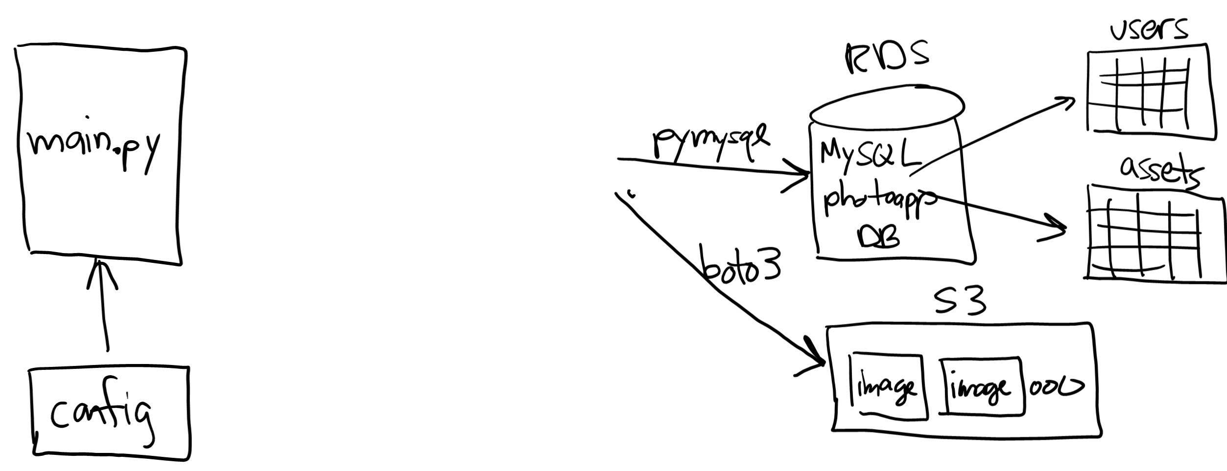
Project 01 => Project 02

Slide 5
Why?
Project 01 works fine…
Why complicate things with another layer of software?
Notes:
Demo: connect to "NU guest" and run app --- can I connect to the database? Probably not… Same thing happens in coffee shops. What happened?

Slide 6

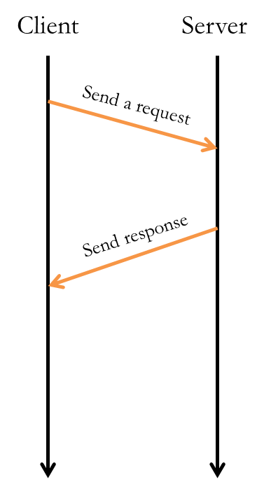

Server-side programming is a VERY DIFFERENT programming style…

Slide 7
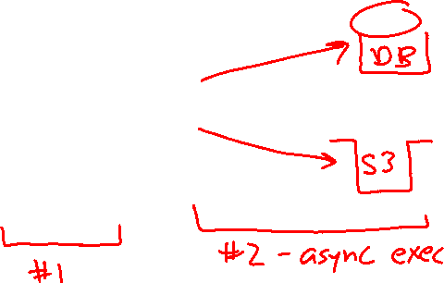
Server-side programming is a VERY DIFFERENT programming style…

Slide 8
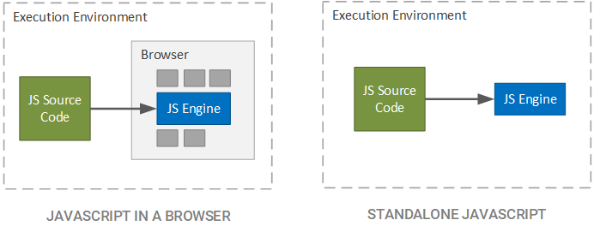
Node.js
JavaScript first appeared as client-side, scripting language
Node.js is runtime engine for executing JS outside browser
Node.js designed for server-side execution
Node.js

Slide 9
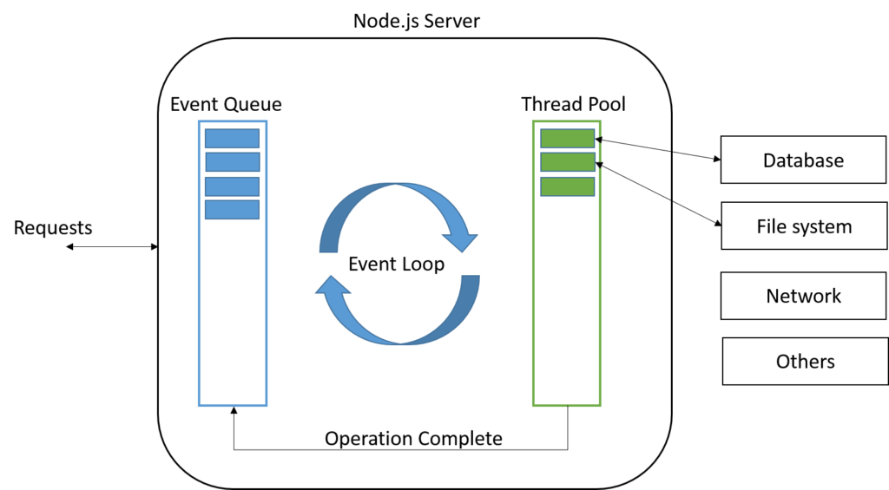


Node.js
Single-threaded with large software library (MySQL, S3, …)
https://nodejs.org/api/documentation.html
Notes:
Look at File System in the documentation --- e.g. read functions return promises! Because FS could be on a separate machine…

Slide 10







Node.js
Single-threaded with large software library (MySQL, S3, …)
https://nodejs.org/api/documentation.html
Notes:
Look at File System in the documentation --- e.g. read functions return promises! Because FS could be on a separate machine…

Slide 11


Slide 12
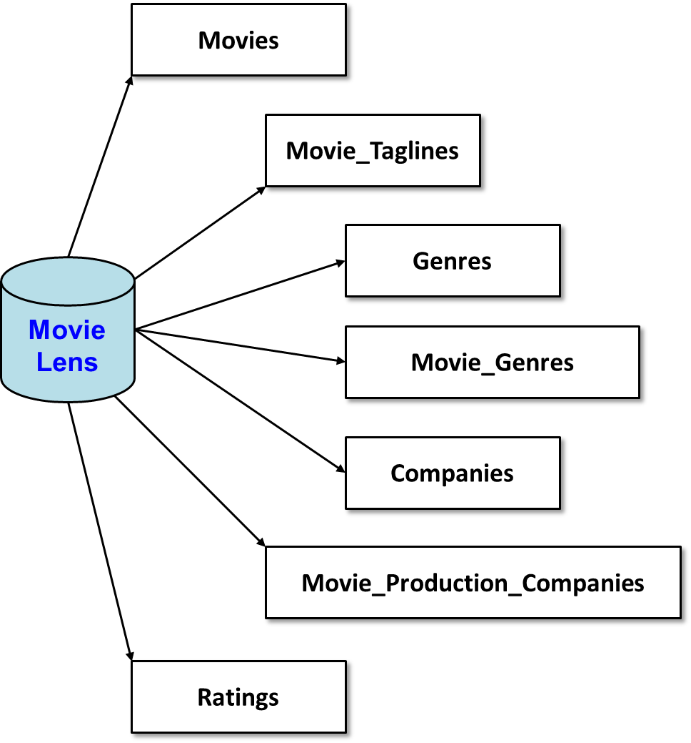
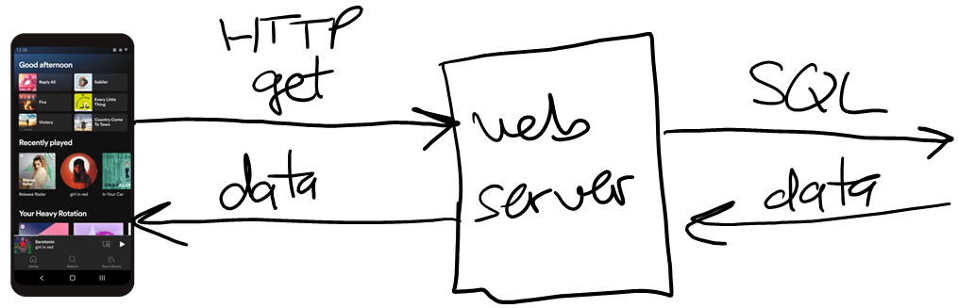
Example from last time
Web service for MovieLens database
app.get('/movies', (req, res) => {…});
app.get('/movies/top10', (req, res) => {…});
// top N with at least M reviews:
app.get('/movies/topNwithM', (req, res) => {…});
// top N with at least M reviews, in given genre:
app.get('/movies/topNwithM/:genre', (req, res) => {…});
Notes:
Make it clear that

Slide 13

/movies
//
// Retrieve all movies in the database:
//
app.get('/movies', (req, res) => {
try {
console.log("call to /movies...");
let sql = "Select * From Movies Order By Movie_ID;";
let params = [];
// execute the SQL:
movielens.all(sql, params, (err, rows) => {
if (err) {
res.status(500).json( {"message": err.message, "data": []} );
return;
}
// send response in JSON format:
console.log("sending response");
res.json( {"message": "success", "data": rows} );
});
console.log("about to return");
}
catch(err) { res.status(500).json({"message": err.message, "data": []}); }
});

Slide 14
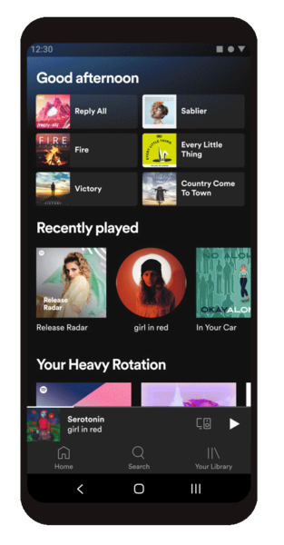
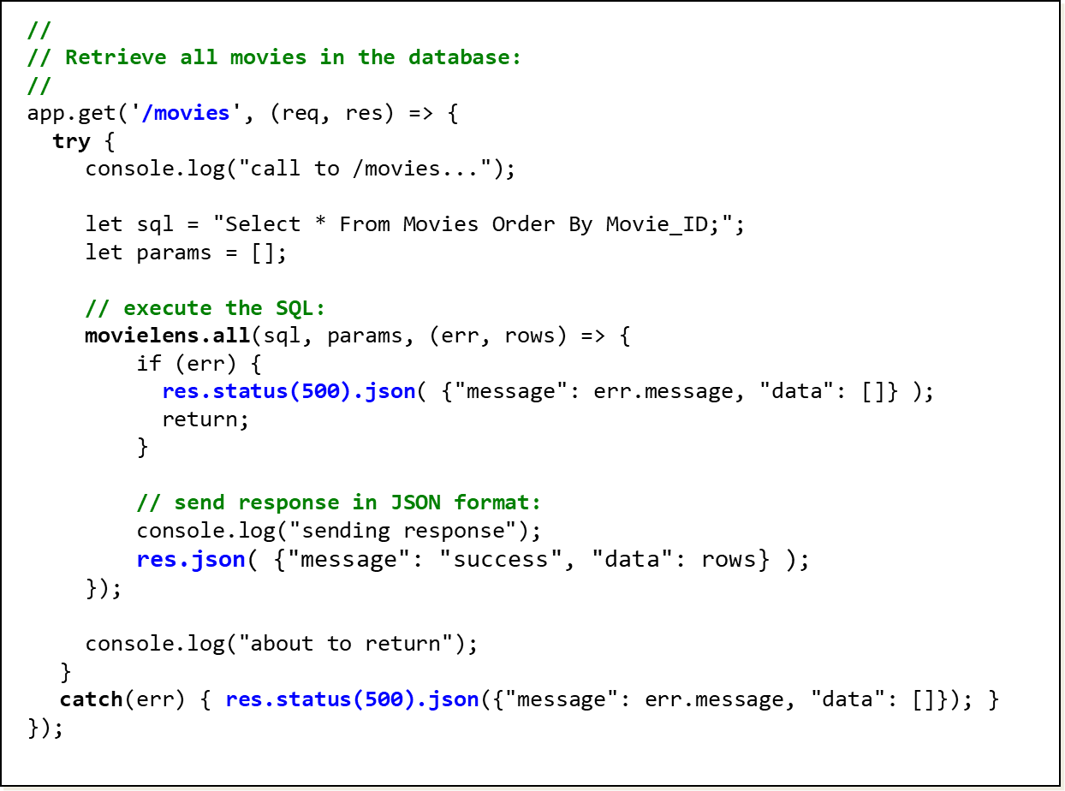


Execution of /movies --- sync vs. async
Movie Lens
Client sees the API as synchronous, i.e. waiting for call to return…
SQL execution is asynchronous on the server side…

Slide 15
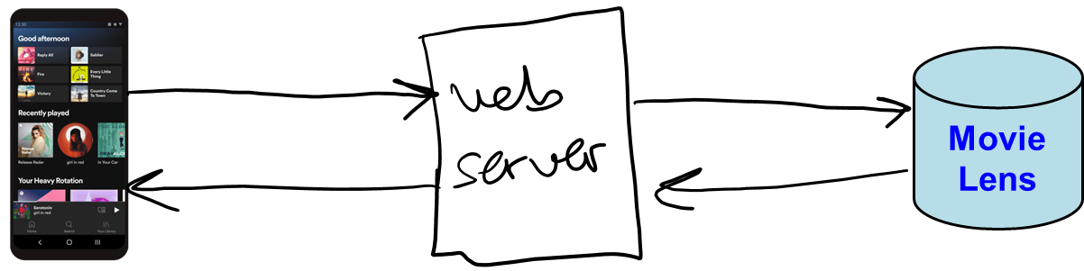
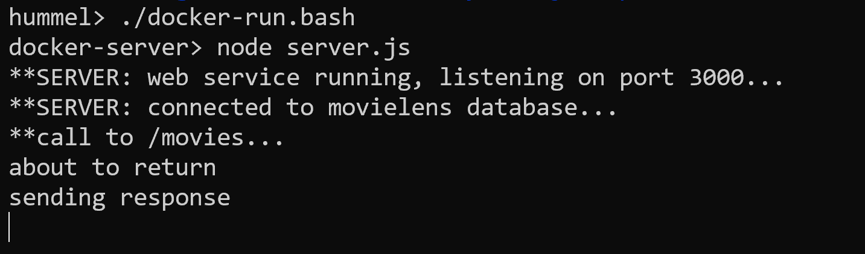
Look carefully at the output…
Notes:
We want to stress that callback is called when query is finished executing
This pattern of callbacks is common in javascript, since it was designed for client-side event processing --- click, mouse move, etc.
You can see this by looking at the order of the console output on the server --- we see the return BEFORE the send

Slide 16
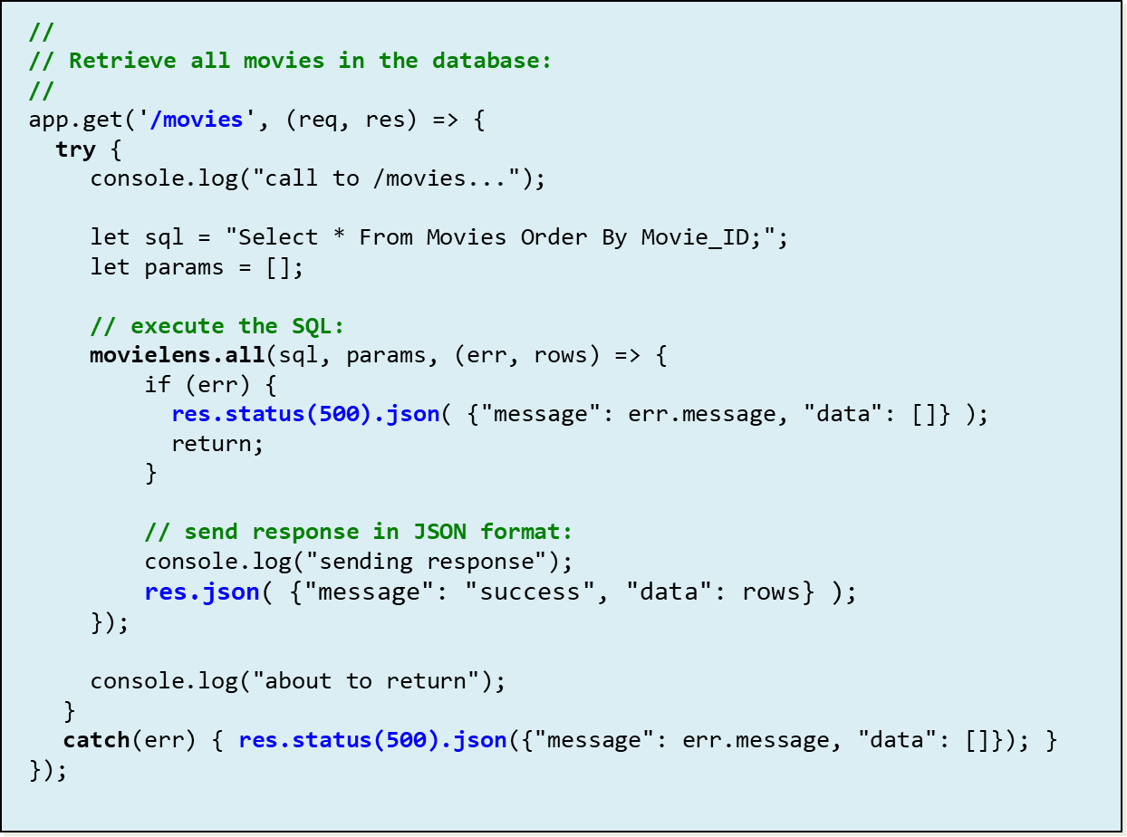
/movies running on Node.js

Slide 17
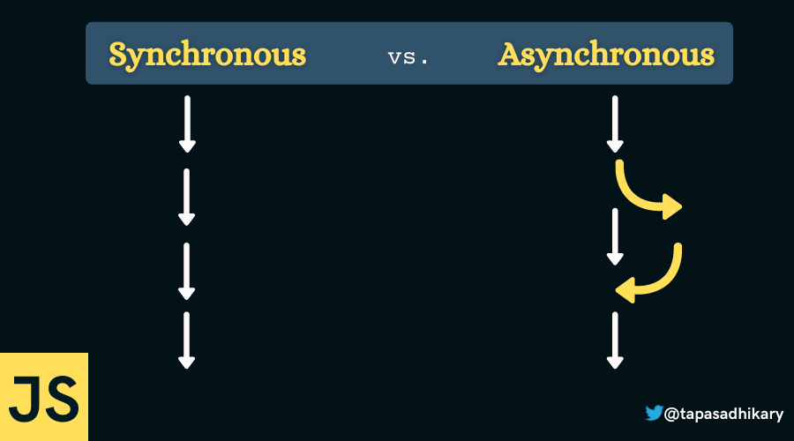
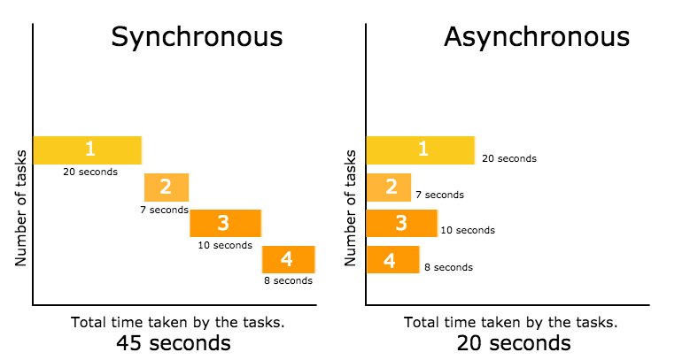
Sync vs. Async

Slide 18
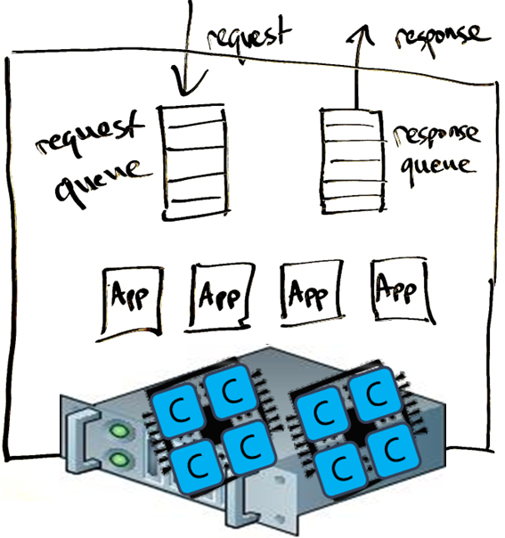
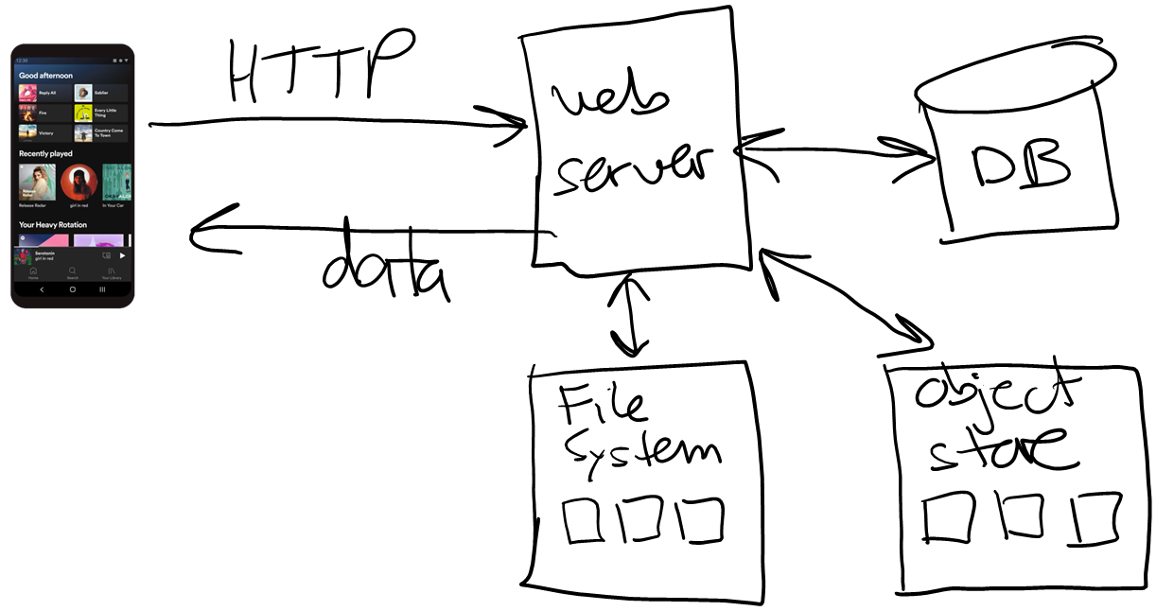
Asynchronous execution
Asynchronous execution on the server frees up resources (threads) to process more requests & responses
Server maintains "in-progress" work queue
Async call is initiated, call-back function added to work Q
When call completes, call-back function executes
Notes:
Draw a work queue to the right of the web server…

Slide 19
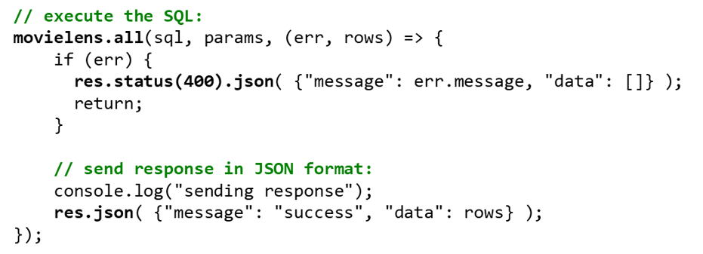
Networking
Networking is inherently unpredictable
You cannot predict how long a network operation will take
Network instability, traffic load, server load, …
Solution?
Most networking libraries / functions are asynchronous
You call to *start* the operation
You go off and do other things…
You are notified when the operation completes (or you can wait for completion)
Grab result

Slide 21
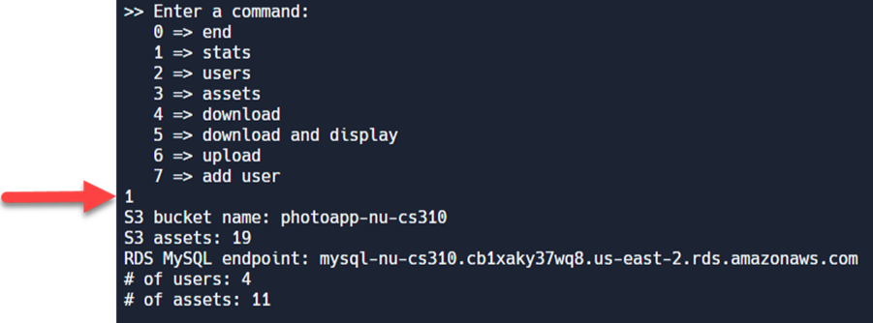
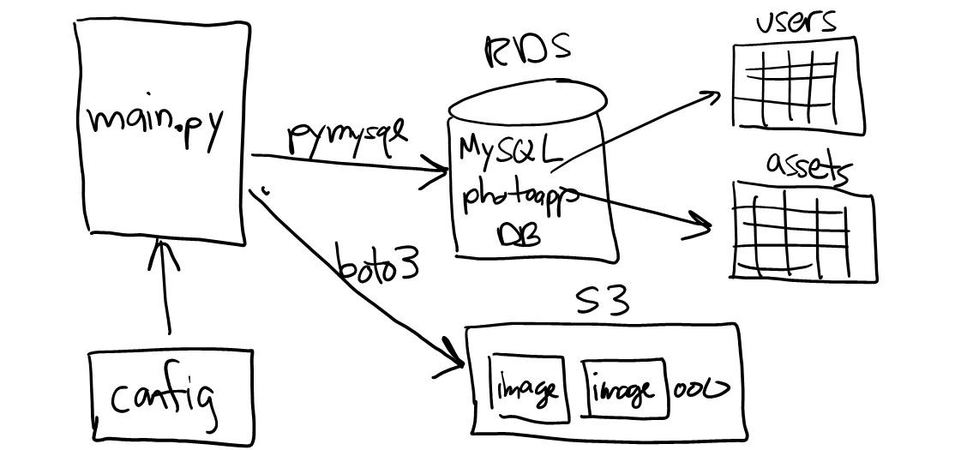
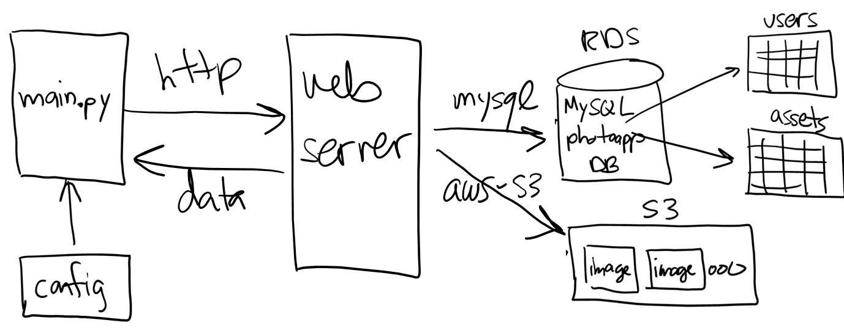
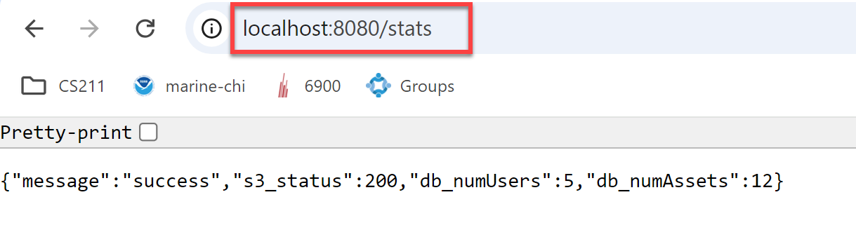
Accessing S3
Recall the "stats" command from project 01…
Project 02 has a similar command…
app.get('/stats', (req, res) => {
call S3, get status code of bucket (200 => okay)
.
.
.
res.json({ "message": ...,
"s3_status": ...,
"db_numUsers": ...,
"db_numAssets": ... });
});

Slide 22
Attempt #1
app.get('/stats', (req, res) => {
console.log("**Call to get /stats...");
let input = {
Bucket: s3_bucket_name
};
let command = new HeadBucketCommand(input);
let s3_response = photoapp_s3.send(command);
res.json({ "message": "success",
"s3_status": s3_response["$metadata"]["httpStatusCode"],
"db_numUsers": -1,
"db_numAssets": -1 });
});
S3 call is asynchronous, you have to wait for response…

Slide 23
Promises
The modern way to wait…
A promise is an object that eventually resolves to a value
When you need the value, you "await" for it
Example: s3.send(…)
app.get('/path', async (req, res) => {
try {
let response = F(params); // F returns a promise
let result = await response;
res.json(result);
}
catch(err) { res.status(500).json(…); }
});

Slide 24
Solution
app.get('/stats', async (req, res) => {
console.log("**Call to get /stats...");
let input = {
Bucket: s3_bucket_name
};
let command = new HeadBucketCommand(input);
let s3_response = photoapp_s3.send(command);
let s3_result = await s3_response;
res.json({ "message": "success",
"s3_status": s3_result["$metadata"]["httpStatusCode"],
"db_numUsers": -1,
"db_numAssets": -1 });
});

Slide 25
Accessing MySQL
The /stats function is also supposed to get the # of users and # of assets in the database…
app.get('/stats', (req, res) => {
call S3, get status code of bucket
call MySQL to get # of users in the users table
call MySQL to get # of assets in the assets table
res.json({ "message": ...,
"s3_status": ...,
"db_numUsers": ...,
"db_numAssets": ... });
});

Slide 26
Callbacks
MySQL library is based on callbacks, not promises…
In this case, the result is ONLY available inside the callback
Example: db.query(…)
app.get('/path', (req, res) => {
try {
db.query(sql, (err, result, …) => {
try {
if (err)
res.status(500).json(err.message);
else
res.json(result);
}
catch(err) {…}
});
}
catch(err) {…}
});

Slide 27
Solution
app.get('/stats', async (req, res) => {
console.log("**Call to get /stats...");
let input = {
Bucket: s3_bucket_name
};
let command = new HeadBucketCommand(input);
let s3_response = photoapp_s3.send(command);
let sql = "select count(*) as NumUsers from users;";
photoapp_db.query(sql, async (err, db_result, _) => {
if (err) {
res.status(500).json({ … });
}
else {
let s3_result = await s3_response;
let row = db_result[0]; // we got one row back, extract it
res.json({ "message": "success",
"s3_status": s3_result["$metadata"]["httpStatusCode"],
"db_numUsers": row["NumUsers"],
"db_numAssets": -1 });
}//else
});
});
We await for S3 inside the callback so it runs concurrently with MySQL…

Slide 28
Design question
The /stats function needs to perform 4 steps:
app.get('/stats', (req, res) => {
(1) call S3, get status of bucket
(2) call MySQL, get # of users in the users table
(3) call MySQL, get # of assets in the assets table
(4) res.json({ "message": ...,
"s3_status": ...,
"db_numUsers": ...,
"db_numAssets": ... });
});
To minimize response time to the client, what's the best way to execute these 4 steps?

Slide 29
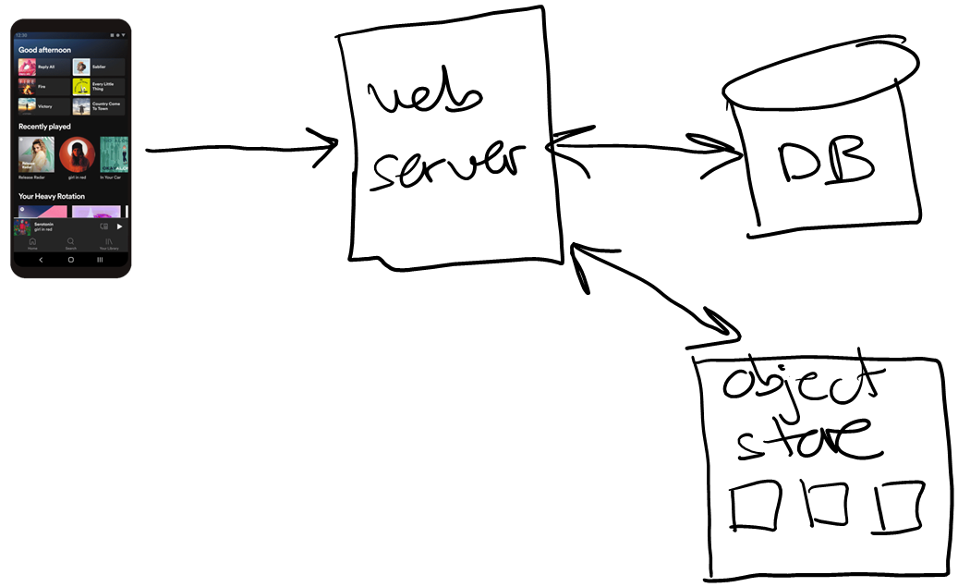
Most efficient approach
Minimize trips across the network, and work concurrently when possible…
Put the SQL queries together into one trip…
Issue S3 and MySQL calls asynchronously so they execute concurrently…
app.get('/stats', async (req, res) => {
F1 = async () => s3.send("HeadBucketCommand"));
F2 = async () => db.query(`Select count(*) from users; Select count(*) from assets;`);
wait(F1, F2);
res.json(...);
});
pseudo-code…

Slide 30
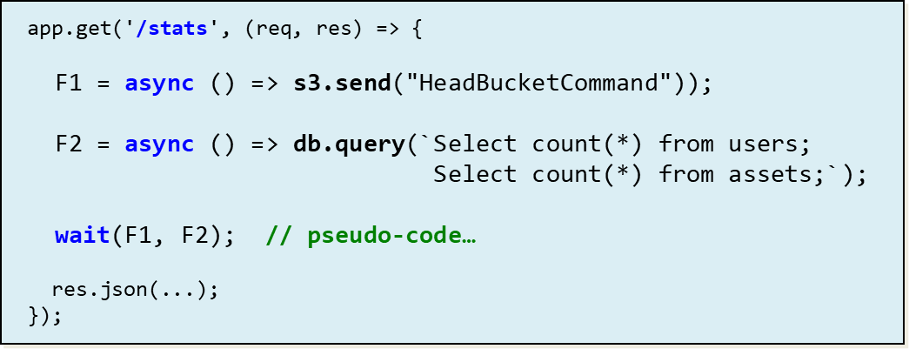
Visualizing execution…
Fork-join…

Slide 31








Visualizing execution…
Fork-join…

Slide 32
That's it, thank you!

